Slide 1
Cascaded HVAC transformers

Slide 2
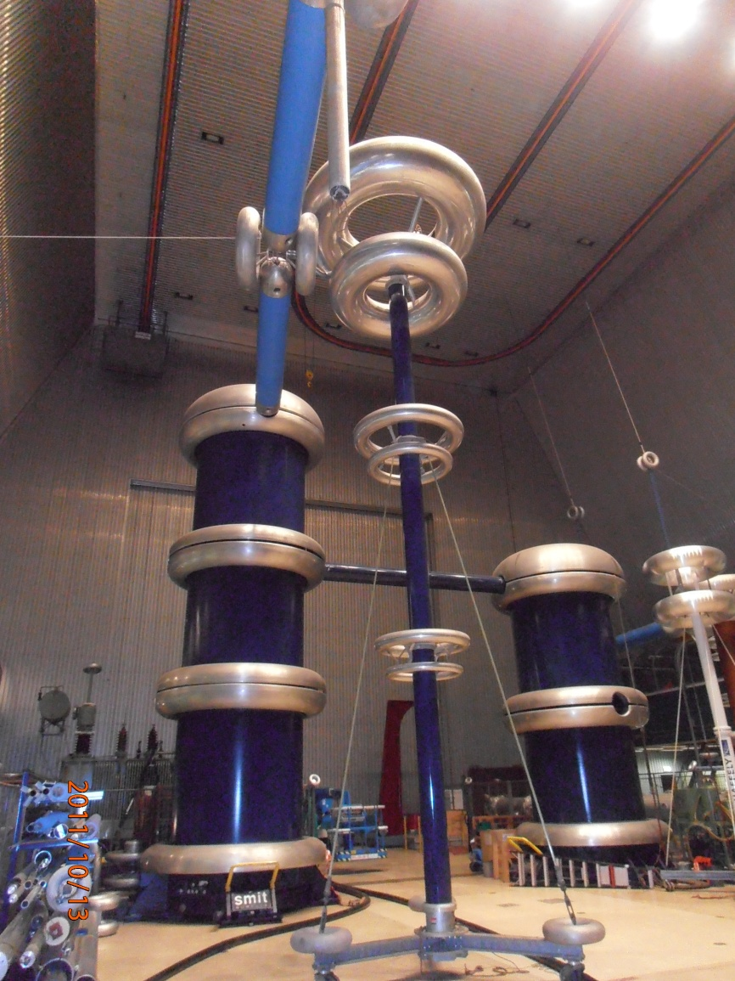
Cascade AC Voltage transformers

Slide 3
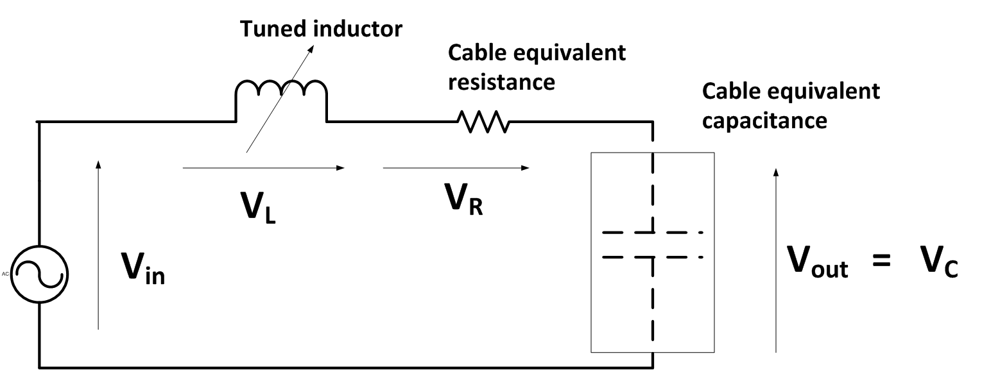

Series tuned resonant HV testing circuit
or

Slide 4
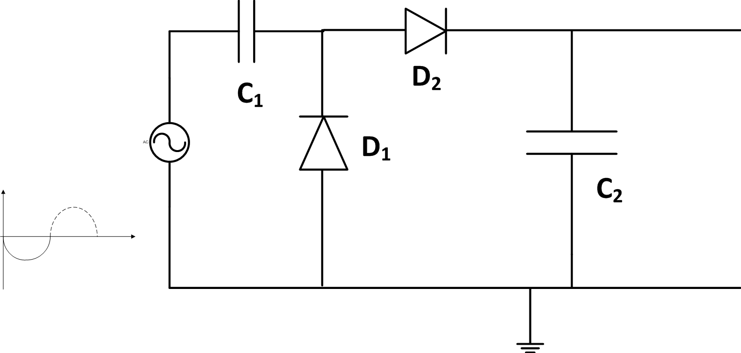
Greinarcher Voltage Doubler Circuit
Oscillating voltage source
Rectifier with smoothing capacitor

Slide 5
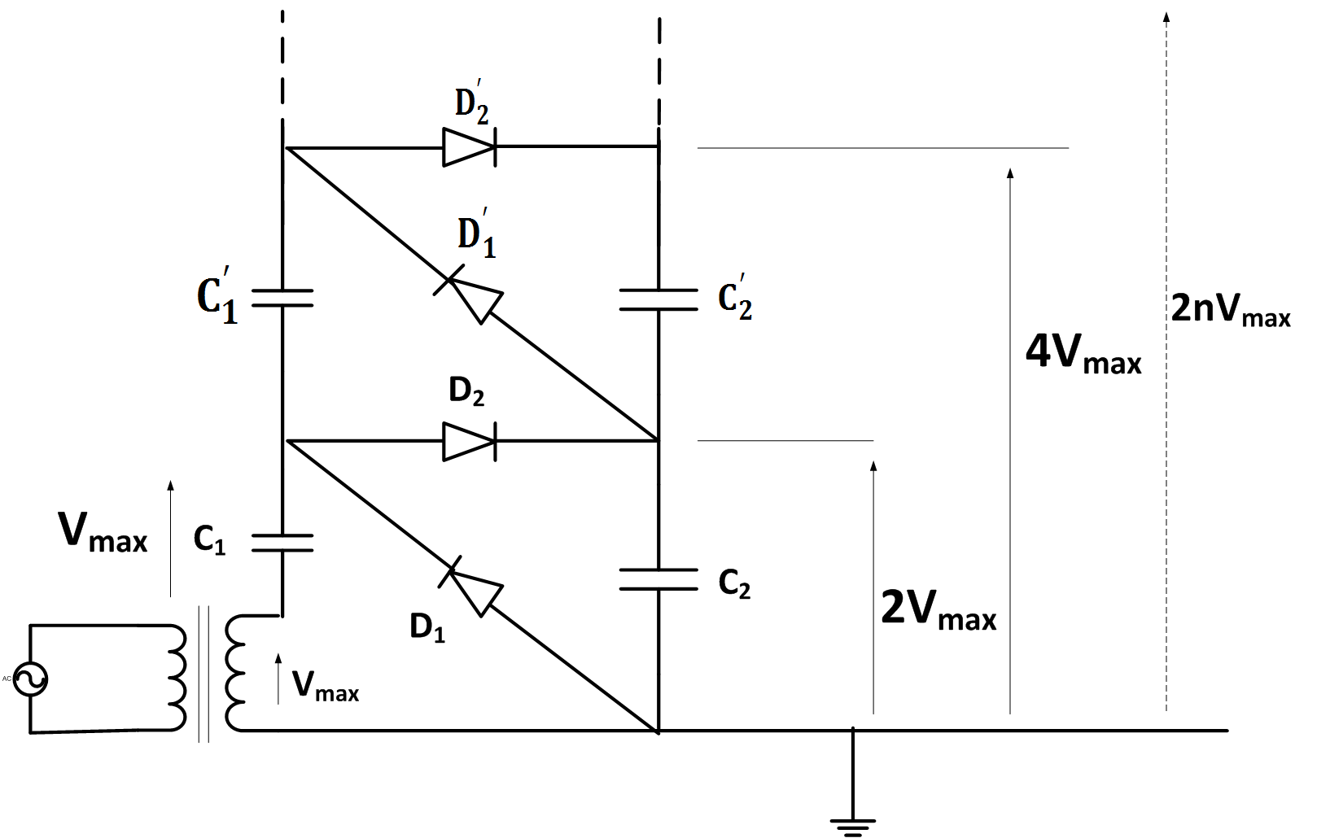
The Cockroft-Walton DC Generator
Oscillating column
Rectified voltage column
Greinarcher circuit

Slide 6
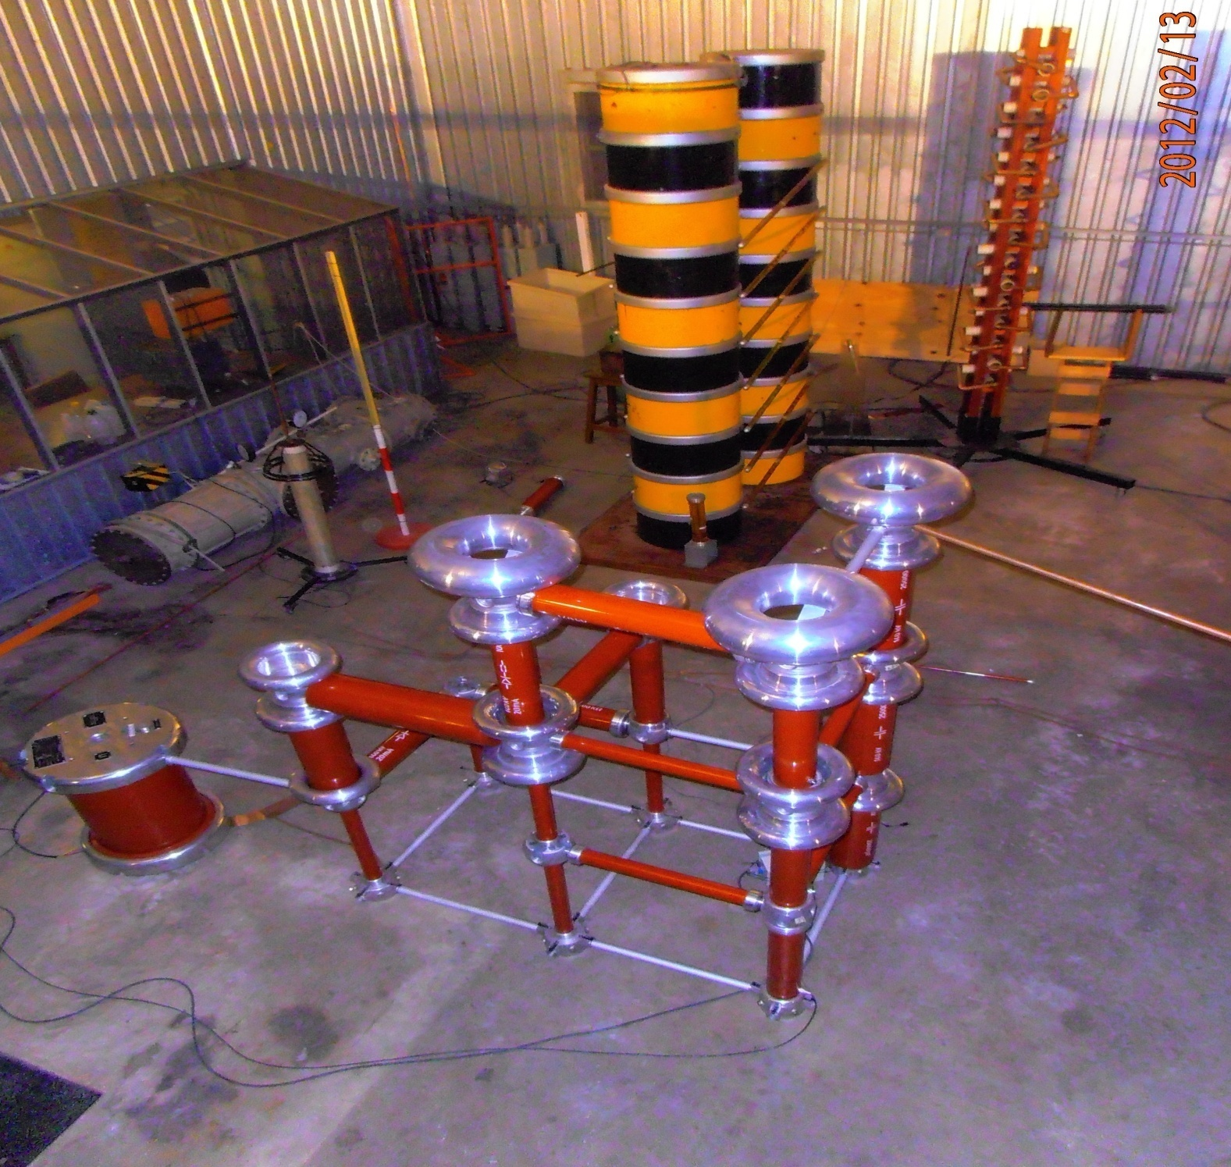

Slide 7
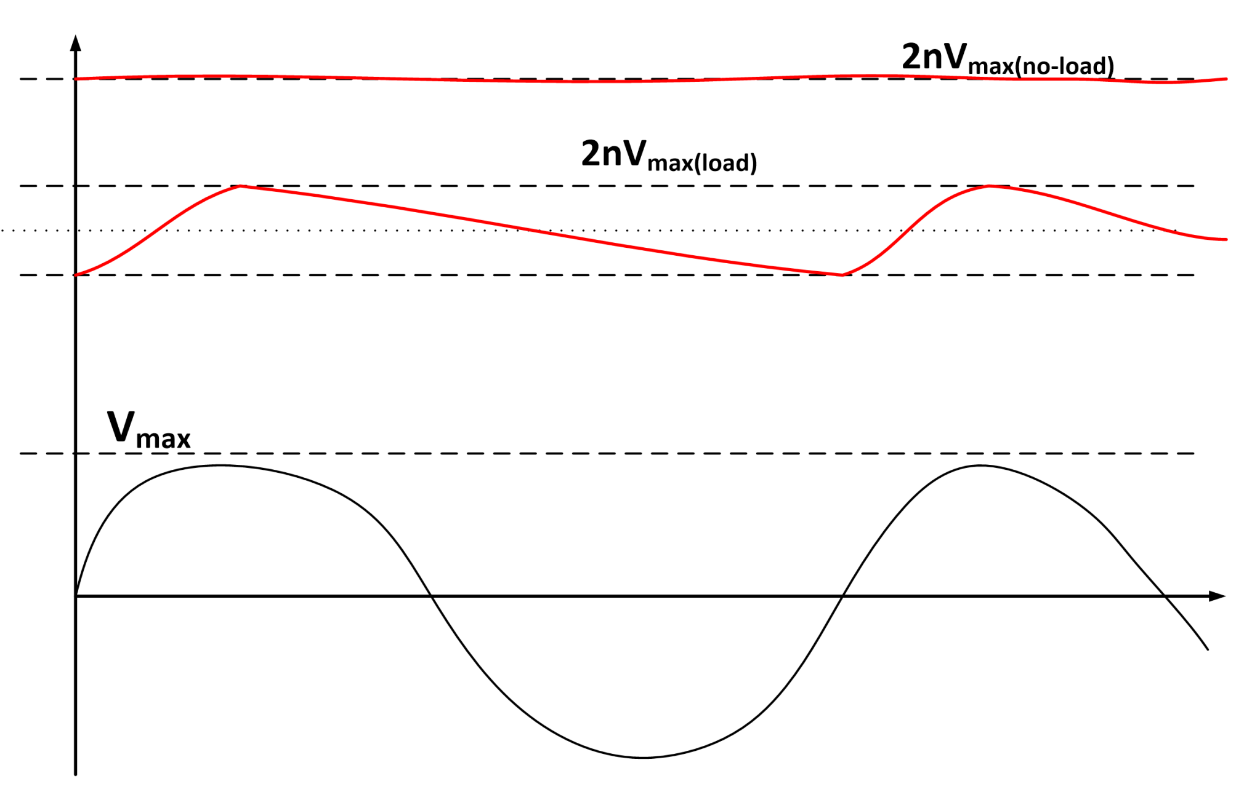



Output Voltage Characteristics

Slide 8




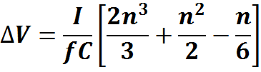
No load output voltage is :
Ripple voltage:
Ripple factor:
% Ripple factor:
Output voltage drop:

Slide 9
